Slide 1
Reliability, Resiliency and High Availability
Module 4

Slide 2
Module Objectives
After this module, participants will be able to:
Understand industry terminologies to describe highly available applications.
Describe best practices outlined by Twelve-Factor-app methodology for building highly available, highly scalable apps.
Notes:
Instructor Notes:
Please review the course objectives with students. Also, ask them why they are taking this course and what are they hoping to achieve.
Participant Notes:

Slide 3
Building Resilient Applications
Notes:
Instructor Notes:
In this section, we will discuss building resilient applications.
Participant Notes:

Slide 4
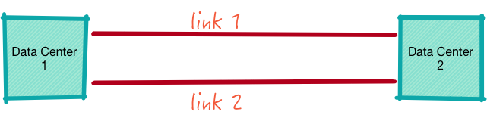
Redundancy
Redundancy is basically 'more than one'.
Examples:
Two links between data centers.
Two power supplies in a computer.
Redundancy allows 'service continuation'.
If one power supply fails on a computer, the other one will keep providing power.
If one link fails, traffic would be re-routed through the other link.
Notes:
Instructor Notes:
Ask students to think of other redundant systems they encounter.
Participant Notes:

Slide 5
Examples of Redundancy
1 + 1 Redundancy
N = Redundancy
When one component fails, the other one takes over.
Could be active / active setup.
Switch over is automatic – usually.
Example: active-active power supplies
for a server.
If only one active component is needed for operation.
Tolerates (N-1) failures.
For example, if we have 3 copies of the database, it can tolerate up to 2 (3-1) databases failing.
Notes:
Instructor Notes:
Instructor Notes are the same as Participant Notes.
Please present the Participant Notes.
Participant Notes:
In 'active-active' systems both components are working. A classic example is two power supplies in a computer.' They will both supply power to the computer.
When one fails, the other power supply will provide all needed power.
In 'active-passive' setup, only one is active. When the active one fails, the passive one will take over.
There is usually a lag time before passive becomes active.
An example would be a database with a backup.
https://en.wikipedia.org/wiki/N%2B1_redundancy

Slide 6

Resiliency
Resiliency: Recover, Self-Heal.
For example, if an app depends on a database, what would happen if the database goes down?
We would like to build apps that are resilient:
That can withstand external service failures.
And gracefully deal with failures.
Think about apps you use on a daily basis that are resilient:
Facebook, Twitter, etc.
Notes:
Instructor Notes:
Participant Notes:

Slide 7
High Availability
High Availability: Refers to a system that is durable and operates exceeding an expected performance.
Usually, this means uptime.
Expressed in percentage of uptime per year.
These are measured in 9s.
Nines
A system that stays up 99% of the time is called 2 nines. This system can be down 14 minutes a day (24 hrs).
A 4 nine system (99.99%) can be down 8.6 seconds a day (24 hrs).
See next slide for more details.
Notes:
Instructor Notes:
Participant Notes:
- https://en.wikipedia.org/wiki/High_availability

Slide 8
Measuring Uptime in Nines
 | Nines | Availability % | Downtime per day | Downtime per month | Downtime per year
 | One nine | 90% | 2.4 hrs | 72 hrs | 36.5 days
 | Two nines | 99% | 14.4 mins | 7.2 hrs | 3.65 days
 | Three nines | 99.9% | 1.44 mins | 43.8 mins | 8.76 hrs
 | Four nines | 99.99 % | 8.66 secs | 4.38 mins | 52.56 mins
-Telco switches - Storage | Five nines | 99.999% | 864.3 ms | 25.9 secs | 5.26 mins
High end flash arrays (HP 3PAR) | Six nines | 99.9999% | 86.4 ms | 2.59 secs | 31.5 secs
 | Seven nines | 99.99999% | 8.64 ms | 262.97 ms | 3.15 secs
 | Eight nines | 99.999999% | 0.864 ms | 26.297 ms | 315.569 ms
Notes:
Instructor Notes:
Instructor Notes are the same as Participant Notes.
Please present the Participant Notes.
Participant Notes:
Telco switches achieving 5 nines availability are only down for 5 mins/year. Pretty good!
The availabilities are usually defined in SLA – Service Level Agreement.

Slide 9

High Availability
Let's say we have a database.
Data stored in the database is safe.
But if the database is down, we can't access the data!
Not highly available.
Example: Bank ATM
If the ATM is down, you can't access your account.
Even though your money is safe in the account.
Notes:
Instructor Notes:
Instructor Notes are the same as Participant Notes.
Please present the Participant Notes.
Participant Notes:
If a bank only had ONE ATM, then it is not very highly available.
So, the bank having many ATMs would be considered highly available.

Slide 10
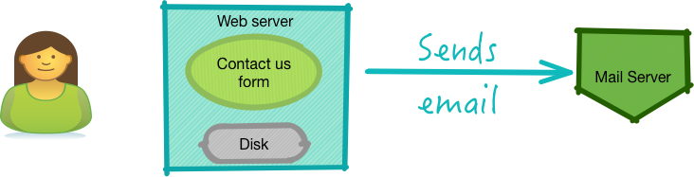
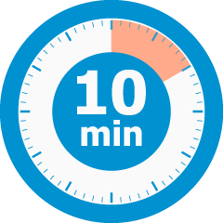
Group Exercise: Analyzing an Application for Resiliency
Scenario:
We have a web form: Contact US.
Contact US collects some information and sends that information, in an email, to the company.
Now, think about scenarios where this app can fail.
Then, think of work-arounds.
Notes:
Instructor Notes:
Purpose: Analyzing a system for potential failures.
Time Estimate: 10 minutes
Discussion Points:
What if the remote mail server connection is refused?
What if the web server fails?
What if the web server disk becomes full?
Participant Notes:

Slide 11
The Twelve-Factor Methodology
Notes:
Instructor Notes:
This section goes over Twelve-Factor methodology.
Participant Notes:

Slide 12

Challenges in Building and Deploying Software as a Service Applications (SaaS)
Nowadays users expect resilient / highly available apps.
Apps like Facebook, Twitter, etc. have set the expectations high.
Developing highly available / resilience applications is not trivial.
The need to deploy applications rapidly and reliably.
The need to control application environments reliably.
Applications usually run on multiple servers for high availability. And many more.
Twelve-Factor App development methodology can help.
Notes:
Instructor Notes:
Ask students to name some web apps / services they rely on.
And if they have experienced any downtime with those services.
Participant Notes:

Slide 13

Twelve-Factor App
'Twelve-Factor App' is a collection of best practices and methodologies for building Software as a Service (SaaS) applications. These practices were gathered at Heroku (cloud platform as a service). Now they are generalized.
These principles are mainly focused on web apps. So adopt these for your environment. The practices are being adopted in Microservices deployment.
Notes:
Instructor Notes:
Instructor Notes are the same as Participant Notes.
Please present the Participant Notes.
Participant Notes:
Heroku (https://www.heroku.com/) is a 'Platform as a Service (PaaS)'. It was created in 2007 and probably the 'first' cloud platform. Initially, it supported Ruby on Rails applications (now it supports many more languages). Heroku became very popular because it made deploying scalable applications very easy.
Acquired by Salesforce in 2010.

Slide 14
Twelve-Factors
Factor | Description
1 – Codebase | There should be exactly one codebase for a deployed service with the codebase being used for many deployments.
2 - Dependencies | All dependencies should be declared, with no implicit reliance on system tools or libraries.
3 – Config | Configuration that varies between deployments should be stored in the environment.
4 - Backing services | All backing services are treated as attached resources and attached and detached by the execution environment.
5 - Build, release, run | The delivery pipeline should strictly consist of build, release, run.
6 - Processes | Applications should be deployed as one or more stateless processes with persisted data stored on a backing service.
7 - Port binding | Self-contained services should make themselves available to other services by specified ports.
8 - Concurrency | Concurrency is advocated by scaling individual processes.
9 - Disposability | Fast startup and shutdown are advocated for a more robust and resilient system.
10 - Dev/Prod parity | All environments should be as similar as possible.
11 - Logs | Applications should produce logs as event streams and leave the execution environment to aggregate.
12 - Admin Processes | Any needed admin tasks should be kept in source control and packaged with the application.
Notes:
Instructor Notes:
We will examine each of these factors in detail in next sections.
Participant Notes:

Slide 15
1 – Codebase
Code and resources (icons etc.) are tracked in version control system.
Version control systems: Git (very popular), Subversion, Mercurial.
One app ←→ one codebase.
Do not share multiple apps within a single codebase – it complicates deploys.
Each app evolves at its own pace.
Multiple deployments are done from a single codebase.
Here we have production, staging and dev.
Notes:
Instructor Notes:
Do a survey of students on which version control systems they use. Count the number of people using git / svn / perforce, etc.
Also, ask students about what they like / dislike in version control systems they have used.
Participant Notes:

Slide 16
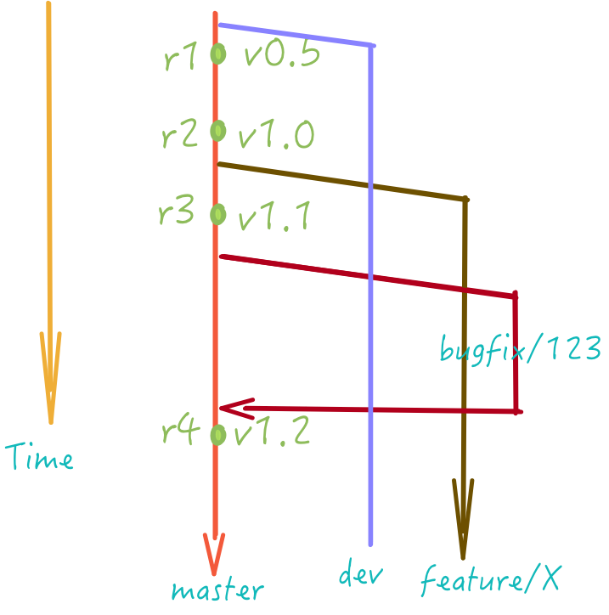
1 – Codebase – Best Practices (git)
Notes:
Instructor Notes:
Explanation next slide.
Participant Notes:

Slide 17
1 – Codebase – Best Practices (Cont.)
(Remember these are not rules, just guidelines. Adopt them to your needs accordingly.)
Master is always 'clean' – as in ready to deploy.
All deploys are done from the master branch.
Each deployment has a unique tag (r1, r2, r3).
So if anything goes wrong with the latest deploy, we can switch back to 'last known good release'.
Each release can optionally have a version tag as well (e.g., v1.1).
Features / bug fixes should be done in a separate branch.
Then merged to master when ready to deploy.
https://sethrobertson.github.io/GitBestPractices/
https://www.git-tower.com/learn/git/ebook/en/command-line/appendix/best-practices
https://www.atlassian.com/git/tutorials/comparing-workflows
Notes:
Instructor Notes:
Ask students to outline some of the best practices they have used for deployments.
Participant Notes:
Adopting best practices in version control can ensure smooth deployments.
Here are some best practices – from git version control system.

Slide 18

2 – Dependencies
Most apps depend on system libraries.
E.g., python apps needing some libraries (compression, image processing, etc.)
Twelve-Factor apps never rely on the implicit existence of system-wide packages.
It declares all dependencies explicitly and exactly (versions).
Even common apps (like curl) are not assumed.
Because they may or may not exist, and the installed versions may not be compatible.
Dependencies are packaged with the application.
We use a 'bundler' tool completely package all files together.
Usually bundled within app directory.
Examples of bundlers:
Ruby has Gem bundler.
Python has pip and virtual environments.
Notes:
Instructor Notes:
Instructor Notes are the same as Participant Notes.
Please present the Participant Notes.
Participant Notes:
Languages like python have a pretty sophisticated packaging / modules system. So it is easy to define all the dependencies.
However, if the app depends on system libraries (like ImageMagic, or libc++) we need to make sure those are installed as well.
This is usually done by containers like Docker that ensures we have exact libraries present in the system.

Slide 19

2 – Dependencies (Cont.)
Here is a sample dependency listing for a
python program.
requirements.txt
BeautifulSoup==3.2.0 Django==1.3 Fabric==1.2.0 PyYAML==3.09 Pygments==1.4 SQLAlchemy==0.7.1
Note how the requirements list
packages and versions.
To install this using python package manager (pip)
$ pip install –r requirements.txt
Notes:
Instructor Notes:
Instructor Notes are the same as Participant Notes.
Please present the Participant Notes.
Participant Notes:
When using Python it is recommended to create a virtual environment for for the application.
Do not install / update system modules – as it may break other scripts that depend on the system lib.

Slide 20

3 – Config
Configurations vary based on deployment environment.
E.g., database host in development might be 'localhost'.
Db host in production might be 'db1.company.com'.
Do not hard-code configs in code.
Also, it is recommended not to check-in config files into version control either.
Sensitive information like passwords will leak.
Sometimes 'sample config files' are checked into version control.
Developers make a copy of this sample file and customize settings in their own config file.
This customized copy is NOT checked into version control.
Notes:
Instructor Notes:
Instructor Notes are the same as Participant Notes.
Please present the Participant Notes.
Participant Notes:
There are multiple formats for specifying config.
XML, JSON, YAML , PLAIN TEXT
XML has been popular in Java environments. However, other simpler formats like YAML and PLAIN-TEXT are getting more adoption.
Choose a format that is supported by your environment.

Slide 21
3 – Config (Cont.)
Checked into version control:
Developer 1:
Staging 1:
App/config /config.template
db.host=""
App/config/config.template (in version control - not modified)
App/config/config.local (customized, NOT in version control)
db.host = "localhost"
App/config/config.template (in version control - not modified)
App/config/config.local (customized, NOT in version control)
db.host = "staging1"
Notes:
Instructor Notes:
Instructor Notes are the same as Participant Notes.
Please present the Participant Notes.
Participant Notes:
Each developer / environment will have a customized file. This file is not checked into version control.

Slide 22
3 – Config (Cont.)
Twelve-Factor apps can specify config dynamically using an environment variable.
# here I am deploying to 'staging'
# assume there is a file : config/staging.yaml
$ ENV=staging ./deploy.sh
# the app / scripts will use all settings in 'config/staging.yaml'
Notes:
Instructor Notes:
Instructor Notes are the same as Participant Notes.
Please present the Participant Notes.
Participant Notes:
When specifying the environment before running the commands, we make sure those env settings are in effect.
This allows a developer to work efficiently with many environments (dev, qa, staging).

Slide 23
4 – Backing Services
A backing service is any service the app uses for operation.
E.g., databases, email service, twitter
A Twelve-Factor app doesn't 'hard code' any backing service URLs in the code.
The same code should work in multiple environments without any code change.
It picks up backing service URLs from appropriate config files (dev, staging, prod).
Notes:
Instructor Notes:
Instructor Notes are the same as Participant Notes.
Please present the Participant Notes.
Participant Notes:
Most web applications depend on some sort of data storage / database for storing data.
MySQL is a very popular relational database. It is open source and very easy to use.
PostgreSQL is also very popular due to its scalability.
Now, cloud vendors are providing 'database as service' that simplifies operations (backups , restore, failover).
Amazon's RDS (Relational Database Service) is one such service.

Slide 24
4 – Backing Service Usage
File : config/staging.yaml
db.host = "staging.example.com"
db.user = "staging_user"
db.pass = "secret123"
File : config/prod.yaml
db.host = "production.example.com"
db.user = "prod_user"
db.pass = "!secret123!"
application code
# config is pointing to appropriate env config file
db_host = confg.get("db_host")
db_user = confg.get("db_user")
db_pass = confg.get("db_pass")
Db_connection = Db.open(db_host, db_user, db_pass)
Notes:
Instructor Notes:
Instructor Notes are the same as Participant Notes.
Please present the Participant Notes.
Participant Notes:
When we load properties from code, the right env properties get loaded (stage, prod, etc.).

Slide 25
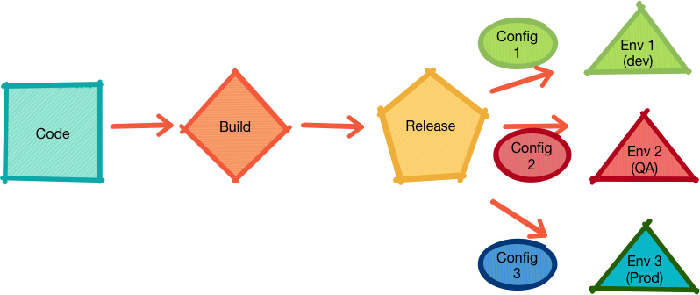
5 – Build, Release, Run
Notes:
Instructor Notes:
This shows a typical development and deployment process.
Build turns code into a release.
Release is then deployed into various environments.
Participant Notes:

Slide 26
5 – Build, Release, Run (Cont.)
Build: Converts code into executable bundles (called build).
Release: Combines build and configuration and deploys to environment.
Run: The app execution.
Twelve-Factor app makes a clear distinction among build/release/run steps.
No code changes in run time, because you can not propagate the changes to build stage.
Each release has a unique release-id.
Timestamp (2018-06-01__13-04-01) or r23
Release tools should allow reverting to previous builds quickly.
Deploy a new build.
Something goes wrong.
Should be able to revert back to last known good build.
Notes:
Instructor Notes:
Instructor Notes are the same as Participant Notes.
Please present the Participant Notes.
Participant Notes:
Build tools for Java: Maven, Gradle.
Build tools for C: Make, Automake.
Build tools for Ruby: Ruby build-tool.

Slide 27

6 – Processes (Run time)
The app is executed in the execution environment as one or more processes.
The process can be a simple python script, or a complicated web application that depends on multiple resources (database, email, twitter, etc.). Twelve-Factor processes are stateless and share nothing.
Stateless
All state and data are stored in 'backing store' (see 4).
So if an app is re-started, it can read data from the backing store and keep continuing.
Share-nothing
Apps don't depend on other apps.
Notes:
Instructor Notes:
Usually, apps are developed in an IDE and also run within an IDE.
But in production, it is a different execution environment.
Participant Notes:
State-less and Share-Nothing architecture allows an app to be scaled easily.
When demand goes up, more processes can be spun up.
When demand subsides, processes can be shut down.
https://12factor.net/processes

Slide 28
6 – Processes (Run time) (Cont.)
How about local stores like memory cache / local disk?
Ok to use transient, intermediate data.
For example, store uploaded file on local drive before uploading a durable storage like S3.
A process restart can wipe local cache memory.
Sticky sessions?
Sticky sessions mean if one process served a user request, it would also serve subsequent requests from the same user.
Session data is usually stored in local storage: memory / disk.
Sticky sessions are in violation of Twelve-Factor design.
We want user request to be served by any process (not just one).
Recommended storing session data in stores like Memcache / Redis.
Notes:
Instructor Notes:
Instructor Notes are the same as Participant Notes.
Please present the Participant Notes.
Participant Notes:
https://12factor.net/processes
Memcached: Free & open source, high-performance, distributed memory object caching system, generic in nature, but intended for use in speeding up dynamic web applications by alleviating database load.
Redis: Redis is an open source (BSD licensed), in-memory data structure store, used as a database, cache and message broker.

Slide 29
7 – Port Binding
Twelve-Factor apps (mostly web apps) listen on a port to serve requests.
Popular ports:
http: 80, 8000, 8080
An app can be run within another container.
Java web apps run within Tomcat container.
Python web apps run within Tornado container.
PHP web apps run within Apache or Nginx web server.
Listening on a port enable one app to service another:
For example, an email app can be a service used by another web app.
Notes:
Instructor Notes:
Instructor Notes are the same as Participant Notes.
Please present the Participant Notes.
Participant Notes:
Apache is a popular web server that supports multiple language stacks: PHP, Python, Java, etc.
https://httpd.apache.org/
Nginx is another very popular web server, focused on performance.
https://www.nginx.com/
Tomcat is a popular as a Java web container.
http://tomcat.apache.org/

Slide 30
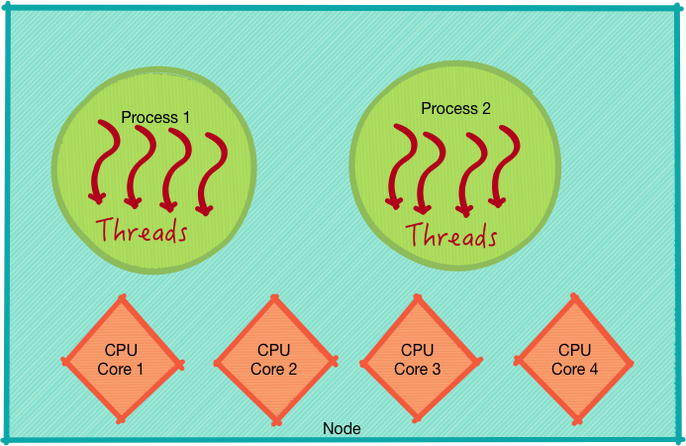
8 – Concurrency
Apps run as multiple processes / threads can utilize hardware better.
Process
'heavy weight'.
Multiple processes can run on same machine utilizing multiple CPU cores and other resources.
E.g., PHP web application process.
Threads
Threads run within a process.
Many threads in a process.
Threads are light weight.
E.g., Java web application thread within Tomcat.
Notes:
Instructor Notes:
Instructor Notes are the same as Participant Notes.
Please present the Participant Notes.
Participant Notes:
Unix popularized the process model. The Unix/Linux operating system can run multiple processes. Each process will have a unique id. A moderate machine can run thousands or processes.
Some processes are short-lived (like doing an 'ls' command). Some are long-lived (mailer daemon).
Threads are much lighter weight than processes. There can be hundreds or thousands of threads per process.

Slide 31

8 – Concurrency (Cont.)
In the twelve-factor app, processes are a first class citizen.
The process concept is closely modeled after Unix/Linux processes.
Traditional web requests are handled by web processes.
Long-running tasks (like sending emails, etc.) can be handled by daemon process.
A single process can run multiple threads inside it, parallelizing the workload:
E.g., Node.js
However, there is only so much vertical scaling, a single process can achieve.
Scaling the app:
Run multiple processes within the same machine.
And scale out to multiple machines.
Twelve-Factor apps should not manage daemon processes. It should use operating systems process / daemon manager.
Notes:
Instructor Notes:
Instructor Notes are the same as Participant Notes.
Please present the Participant Notes.
Participant Notes:
A Linux/Unix system can run thousands of concurrent processes.

Slide 32
9 – Disposability
The twelve-factor app’s processes are disposable, meaning they can be started or stopped at a moment’s notice.
This facilitates fast elastic scaling, rapid deployment of code or config changes, and robustness of production deploys.
The process should startup fairly quickly (few seconds at most).
This allows load balancers to scale up processes as the demand increases.
Also, processes can be moved to another machine.
The process should shutdown quickly and gracefully as well.
Used to restart / redeploy apps quickly.
Twelve-Factor apps are designed to handle unexpected / sudden terminations.
To prevent data loss due to sudden crashes, save the data in backup store.
Notes:
Instructor Notes:
Instructor Notes are the same as Participant Notes.
Please present the Participant Notes.
Participant Notes:
We use Unix signal SIGTERM to tell processes to shutdown. When a process gets the signal, it should finish serving current requests and shutdown quickly.

Slide 33
10 – Dev/Prod Parity
Traditionally there is a substantial gap between development and production.
There are three main areas where we see this gap.
The Time Gap
The Personnel Gap
The Tools Gap
Developer can work on features that can take days / weeks / months before it goes into production.
Developers write code, ops-engineers deploy it.
Developer stack: light-weight httpd, SQLite on Mac OSX.
Production stack: Nginx, MySQL on Linux.
Notes:
Instructor Notes:
Survey students on their favorite dev setup
Editors / IDEs
Databases
Languages / Environments
Participant Notes:

Slide 34
10 – Dev/Prod Parity (Cont.)
The twelve-factor app is designed for continuous deployment by keeping the gap between development and production small.
Make the time gap small: A developer may write the code and have it deployed hours or even just minutes later.
Make the personnel gap small: Developers who wrote the code are closely involved in deploying it and watching its behavior in production.
Make the tools gap small: Keep development and production as similar as possible.
 | Traditional app | Twelve-factor app
Time between deploys | Weeks | Hours
Code authors vs. code deployers | Different people | Same people
Dev vs. production environments | Divergent | As similar as possible
Notes:
Instructor Notes:
Participant Notes:

Slide 35

10 – Dev/Prod Parity (Cont.)
Twelve-Factor app principal urges developers to use same backing store in development and production.
E.g., if MySQL is used in production, developers should also use MySQL on their development machines.
Because sometimes tiny discrepancies in data storage can lead to problems that are hard to trace.
E.g., how integers are represented (max / min values).
Running stores used in production (MySQL, PostgreSQL) on dev machines is easier now.
Most of them can be installed and run natively.
Or use light-weight containers like Docker and Vagrant to run the app.
It is even recommended to use the same version of backing store in dev and production.
There can be subtle version incompatibility bugs.
Notes:
Instructor Notes:
Instructor Notes are the same as Participant Notes.
Please present the Participant Notes.
Participant Notes:
Traditionally VMs are used to run isolated environments on a dev machine. But VMs are heavy in resource utilization.
Docker is a modern container format that is light-weight and works universally.
https://www.docker.com/

Slide 36
11 – Logs
Logs provide visibility into the behavior of a running app. Logs are commonly written to a file on disk (a “logfile”).
Logs are critical for:
Diagnosing bugs / exceptions happening in the program.
Understanding app behavior – INFO level logs, metrics.
Twelve-Factor app is highly encouraged to log:
Exceptions and errors.
INFO, DEBUG level messages to log the working of the app.
However, the app should not manage log files:
Use a logging tool.
Logging tool will save the logs to a destination (disk file, database, etc.) according to the configuration.
Notes:
Instructor Notes:
Instructor Notes are the same as Participant Notes.
Please present the Participant Notes.
Participant Notes:
We recommend using loggers in your program from day one.
Most developers start with PRINT() and before long there are too many PRINT statements littered in the code.

Slide 37

11 – Logs (Cont.)
Don't log using PRINT():
It is hard to turn on / off.
And selectively turn on logging for a component.
Loggers
Java: Log4j.
Python: PyLogger.
Log Levels: DEBUG > INFO > WARN (default) > ERROR.
Loggers can send the output to any number of destinations (or a combination).
Disk files, Database, Network service, a message queue.
Loggers can also 'rotate' files – based on timestamp or size. And loggers allow us to turn logging for separate components on / off. E.g., Component A = LogLevel.DEBUG, Component B = LogLevel.INFO
Notes:
Instructor Notes:
Instructor Notes are the same as Participant Notes.
Please present the Participant Notes.
Participant Notes:
There are usually more than one logger per language. We recommend using one that has wide adoption and easy to use API.

Slide 38

12 – Admin
There are steps needed to set up the application so it is ready to run.
For example:
Setting up database schema.
Seeding some initial data (like zip code lookup data, etc.).
Setup scripts are part of app. Setup scripts use environment config to setup. Include 'one time' scripts too.
For example:
php scripts/fix-bad-records.php
Notes:
Instructor Notes:
Instructor Notes are the same as Participant Notes.
Please present the Participant Notes.
Participant Notes:
Most admin tasks can be done as 'user'. We don't need 'admin' privileges.
It is recommended to run web apps NOT as admin user.
Usually a special user is created to run web apps.

Slide 39
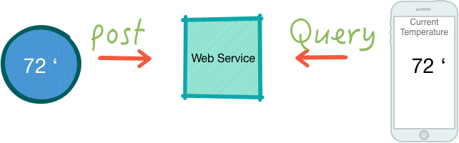
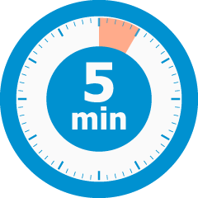
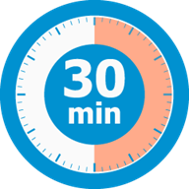
Group Exercise: Design Lab
Design Lab:
We are going to design a IOT (Internet of Things) service.
Imagine we have an IOT device – a thermostat - at home.
The IOT device reports temperature data to a web service.
We also have a web service that the user can access to see the current temperature at their home and we keep the historical temperature readings.
Notes:
Instructor Notes:
Time: 20-30 Minutes
Participant Notes:
Instructions:
Self-organize into 3 or 4 groups.
Sit together so can discuss freely.
Design the system that is highly available and resilient.
Think of all the components that could be needed for a service of this nature.
Do we need a datastore? What kind? etc.
Present your design to the class.
Each group presents their design.
We will learn together!

Slide 40
Appendix
Notes:
Instructor Notes:
Participant Notes:

Slide 41
Further Readings
The 12 Factor App
https://12factor.net/

